Slide 1
Small Regulatory RNA II
Mary (Junyan) Li
Millar Lab
junyan.li@anu.edu.au

Slide 2
MicroRNA Biogenesis
miRNA*
miRNA
Target gene
DNA
Pri-miRNA
Target transcript
Dicer
Pre-miRNA
Dicer/Droshar
miRNA*
miRISCs
miRNA
ds-miRNA (21 nt)
Nucleus
Cytoplasm
miRNA
miRNA*
PTGS (Post transcriptional gene silencing)
miRISCs (miRNA loaded RNA-Induced
Silencing Complex)

Slide 3
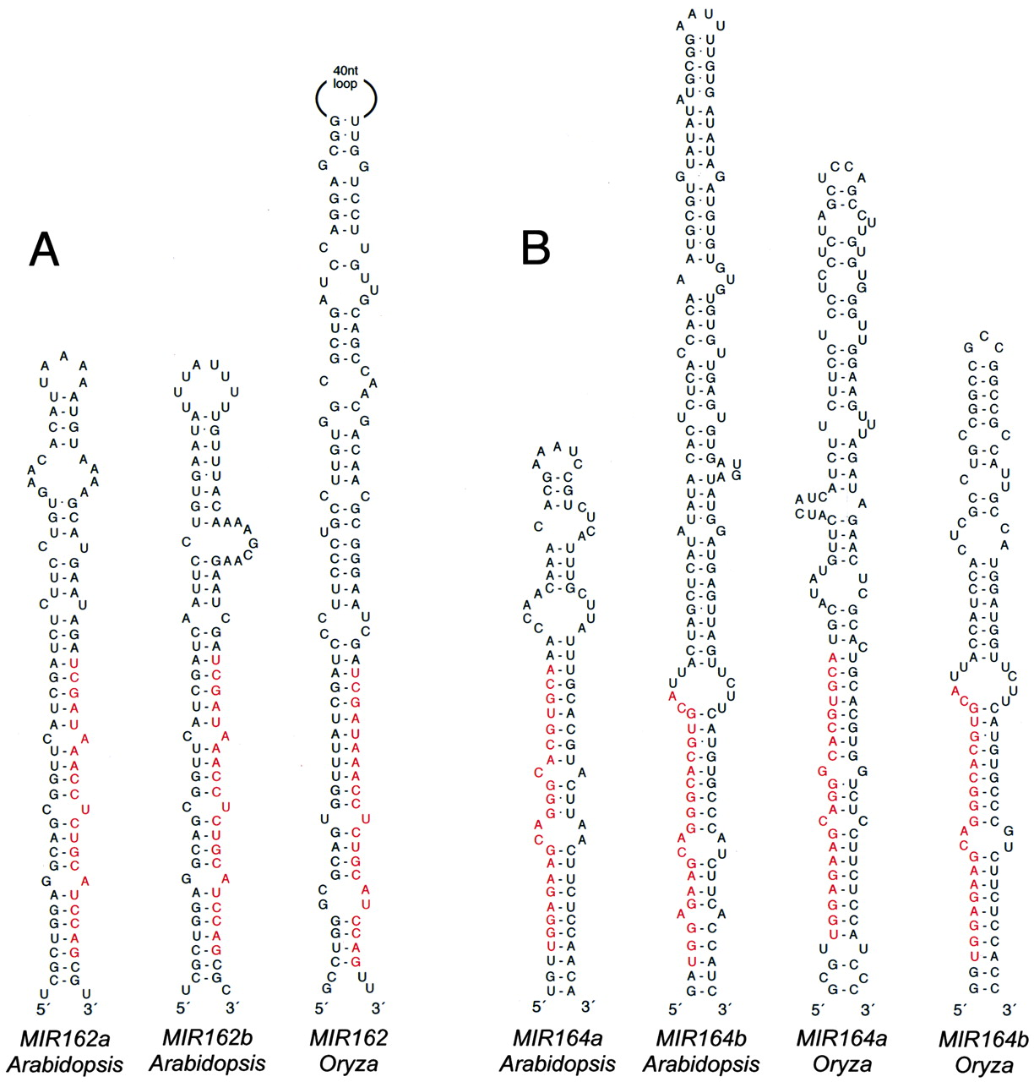
MiRNA are processed from imperfect stem-loops
Genes Dev. 2002;16:1616-1626

Slide 4
MiRNA silence targets through degradative and non-dagradative pathways
Degradative:
mRNA Cleavage (Predominant in plants)
Deadenylation followed by mRNA decay(Animal)
AAAAAAA
Non-degradative:
Translational Repression (Plant and animal)
Protein
Notes:
microRNA gene is transcribed and processed into mature miRNA. The miRNA is then incorporated into RISC and guides the RISC to bind onto the target. 2 mins

Slide 5
Plant MiRNAs are extensively and highly complementary to targets
Cleavage site
5’
Target
miRNA
21 20 19 18 17 16 15 14 13 12 11 10 9 8 7 6 5 4 3 2 1
3’ region
5’ seed region
miRNA cleave mRNAs between position 10 and 11

Slide 6
Animal miRNAs have low complementarities to targets
5’
Target
miRNA
21 20 19 18 17 16 15 14 13 12 11 10 9 8 7 6 5 4 3 2 1
3’ region
5’ seed region
In most cases, only need nucleotide 2-7 (seed region) to interact and repress target.
MicroRNA are thought to regulate at least 30-50% of all human genes.

Slide 7
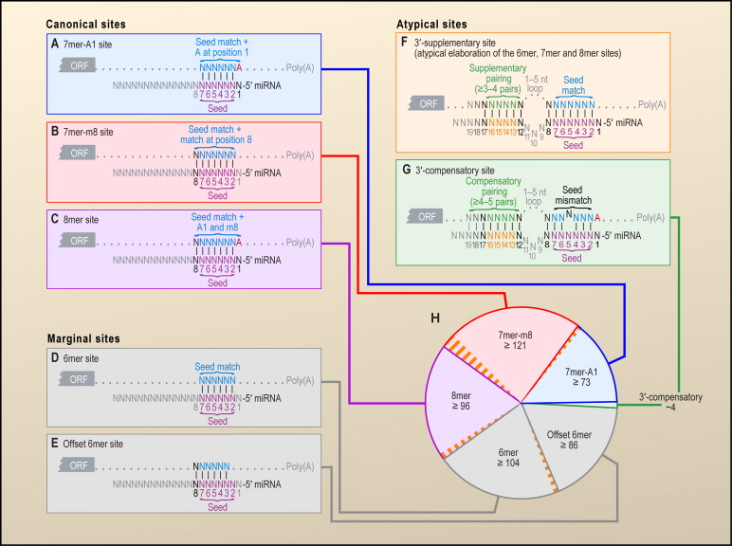
Diversity of animal miRNA target sites
Bartel 2009. Cell 136
Notes:
Types of miRNA Target Sites
(A–C) Canonical, 7–8 nt seed-matched sites. Vertical dashes indicate contiguous Watson–Crick pairing.
(D–E) Marginal, 6 nt sites matching the seed region. These 6mer sites typically have reduced efficacy (Figure 4A) and are conserved by chance more frequently
than the larger sites. Therefore, when prioritizing site efficacy and prediction specificity, prediction algorithms with stringent seed-pairing criteria disregard 6mer
sites.
(F–G) Sites with productive 3′ pairing. For 3′-supplementary sites (F), Watson–Crick pairing usually centering miRNA nucleotides 13–16 (orange) supplements
a 6–8 nt site (A–E). At least 3–4 well-positioned contiguous pairs are typically required for increased efficacy, which explains why 3′-supplementary sites are
atypical. For 3′-compensatory sites (G), Watson–Crick pairing usually centering on miRNA nucleotides 13–16 (orange) can compensate for a seed mismatch
and thereby create a functional site.
(H) Number of preferentially conserved mammalian sites matching a typical highly conserved miRNA (Friedman et al., 2008). For each site matching the seed
region, orange-hatched subsectors indicate the fraction of conserved sites with preferentially conserved 3′-supplementary pairing. Analysis was performed
with the 87 miRNA families highly conserved in vertebrates. A 7mer site is counted only if it is not part of an 8mer site, and a 6mer site is counted only if it is not
part of a larger site. Values plotted are the number of preferentially conserved sites confidently detected above background, calculated as the average number
of conserved sites minus the upper 95% confidence limit on the sites estimated to be conserved by chance. Thus for each site type of panels (A)–(E), there is
95% confidence that the actual average of preferentially conserved sites is higher than that plotted.

Slide 8
Factors beyond complementarity are also critical to miRNA:target interaction
Overall complementarity and pattern
Target accessibility/2nd structure
(A)n
(A)n
(A)n
(A)n
RNA binding protein
miRNA:target stoichiometry
Target Expression
[miRNA]
RBP
(A)n
[Target mRNA]
RBP
(A)n

Slide 9
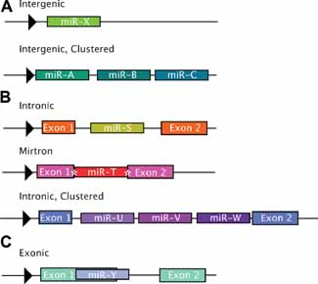
Genomic organization of MIRNA genes
J Cell Physiol. 2010 Mar;222(3):540-5
Notes:
Genomic location of miRNAs. A: Intergenic miRNAs are found in genomic regions distinct from known transcription units. These miRNAs can be monocistronic (top part) with their own promoters (black arrowhead), or polycistronic, where several miRNAs are transcribed as cluster of primary transcripts (bottom part) with a shared promoter (black arrowhead). B: Intronic miRNAs are found in the introns of annotated genes, both protein coding and noncoding. These miRNAs can be present as a single miRNA (top part) or as a cluster of several miRNAs (bottom part). Intronic miRNAs are thought to be transcribed from the same promoter as their host genes (black arrowhead, all parts) and processed from the introns of host gene transcripts. In the special case of mirtrons (middle part), the intron is the exact sequence of the pre-miRNA with splice sites on either side (denoted by white asterisks). In this case, the Microprocessor complex is thought to be unnecessary in mirtron maturation (Okamura et al., 2007). C: Exonic miRNAs are far more rare than either of the types above and often overlap an exon and an intron of a noncoding gene. These miRNAs are also thought to be transcribed by their host gene promoter and their maturation often excludes host gene function (Rodriguez et al., 2004

Slide 10
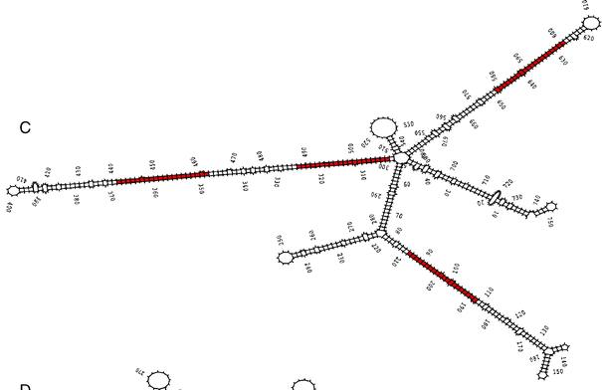
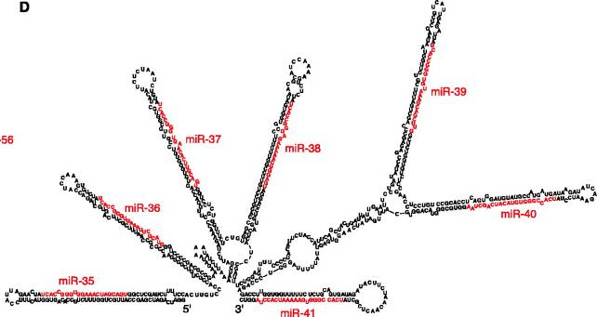
Primary-miRNA can be polycistronic
Clusters
Drosophila:
50% miR genes
in clusters
Mouse cluster-
51 miR genes
miRs can be
sequence related
Rice
Worms
Notes:
Somewhere between 36% and 47% of miRNAs are found in
clusters in zebraﬁsh, mouse, and human (Grifﬁths-Jones et al.,
2008; Thatcher et al., 2008) (Fig. 2). Indeed, 55 and 51 distinct
miRNA clusters exist in the human and mouse genomes,
respectively
Based on analysis of protein
interaction networks, it has been proposed that the mRNA
transcripts coding for proteins that interact with each other are
typically targeted by miRNAs from the same polycistronic
cluster (Yuan et al., 2009). This ﬁnding is important because it
implies extremely complex miRNA regulation of genetic
networks and pathways and seems to indicate even more
carefully nuanced regulation by miRNAs than was perhaps
expected.
miRNAs encoded within oth
The seven microRNAs of the mir-35 cluster appear to be expressed only during embryogenesis as assayed by northern blots and a GFP reporter. A deletion that removes the seven microRNAs in the mir-35 cluster results in a temperature-sensitive late embryonic or L1 lethal phenotype, while deletions that remove mir-37 through mir-41, mir-42 alone, or mir-37 through mir-42 do not cause lethality. Thus, expression of just mir-35 and/or mir-36 is sufficient for normal development, indicating either that mir-35 and/or mir-36 are the only microRNA(s) in this family required for development or that they function redundantly with the other members of the family

Slide 11
MiRNA identification pipeline
Small RNA read data
Do reads map to genome and form a hairpin?
Do the reads have consistent 5’ processing and presence of a star sequence?
Are the two products complementary when folded?
Blast search mature product against miRBase

Slide 12
How many potential miRNA genes are there in genomes
Current estimates of the number of miRNA genes present:
Animals
Human (1872)
Mouse (1186)
Worm (223)
Fly (238)
Plants
Arabidopsis (298)
Rice (592)
Cotton (352)
Moss (229)
Viruses
Epstein barr (25)
Herpes simplex (18)
Kaposi herpes (13)
Possibly several thousand miR in complex species, that are not conserved – species specific
- MiR genes can rapidly evolve - may correspond to the differences we see between species.
Notes:
elegans

Slide 13
Some microRNAs are deeply conserved
miR166
let-7
PHABULOSA
lin-41
Leaf development
Vascular patterning
Late larval to
Adult cell fate
Land Plants
Flowering
Non-flowering
Fern
Lycopod
Moss
Liverwort
Hornwort
Bilaterian Animals
Vertebrate,
Sea squirt (ascidian)
Hemichordate,
Mollusc,
Annelid
Arthropod
~400 million years

Slide 14
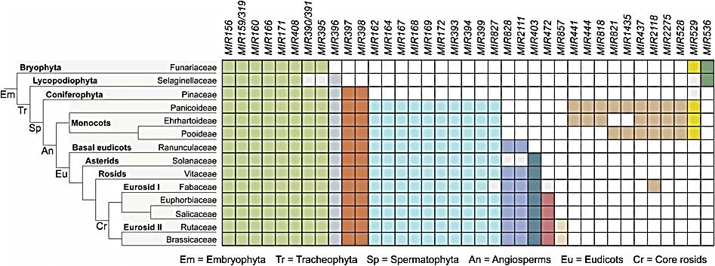
Some MIR gene families are present in all plants or all angiosperms
These are conserved in all angiosperms
These are conserved in all plants
Cuperus, J.T., Fahlgren, N., and Carrington, J.C. (2011). Evolution and Functional Diversification of MIRNA Genes. Plant Cell: tpc.110.082784.

Slide 15
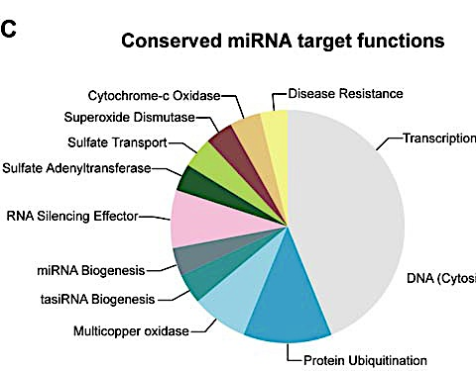
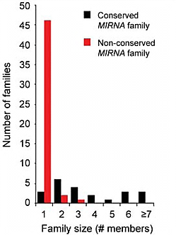
Some miRNAs are deeply conserved and important gene regulators
Nearly half of the targets of conserved miRNAs are transcription factors.
Factors
Non-conserved MIRNA families usually occur as single genes
Conserved ones have often duplicated to larger gene families
Fahlgren, N., Howell, M.D., Kasschau, K.D., Chapman, E.J., Sullivan, C.M., Cumbie, J.S., Givan, S.A., Law, T.F., Grant, S.R., Dangl, J.L., and Carrington, J.C. (2007) High-throughput sequencing of Arabidopsis microRNAs: Evidence for frequent birth and death of MIRNA genes. PLoS ONE. 2007; 2(2): e219.

Slide 16
MicroRNAs can alter the genomic output of a cell
miR-124
(Brain-specific miRNA)
Hela Cells
Hela Cells
miR-1
(Muscle-specific miRNA)
mRNA output becomes more like brain cells
mRNA output becomes more like muscle cells
One miRNAs can regulate the expression of many genes.
Lim et al., (2005), Nature 433;769

Slide 17
MiRNAs provide buffering to genetic programs and robustness to development
Expression level
miRNA
buffering
Target
Differentiation
Primary regulation - Transcription; Secondary regulation - miRNA
Notes:
Finally, additional mechanisms might be in place at
the RNA level to provide robustness and guard against transcrip­tional fluctuations.
It has been proposed that high levels of transcrip­tion coupled with inefficient translation can lower intrinsic noise in
protein output.

Slide 18
MicroRNAs provide buffering to genetic programs and robustness to development
Expression level
miRNA
buffering
Target
Differentiation
Primary regulation - Transcription; Secondary regulation - miRNA
Notes:
Biological systems can compensate for genetic and environmental
perturbations. Genetic buffering allows invariance of the phenotype
in the face of perturbations. This endows the organism with reduced
susceptibility to mutations and results in robustness. External
perturbations may arise from changes in the environment, whereas
internal factors derive from inexact processes within a cell such as
transcriptional bursts, changes in gene dosage and leaky transcrip­tion. This variation in gene expression may lead to fluctuation in
activity, limiting the accuracy of specific cellular processes.
In order
to prevent these fluctuations from having a severe impact on pheno­type, several mechanisms for providing robustness have evolved.
First, creating networks of feedback and feedforward loops can reduce the
effects of variation by stabilizing different phenotypic states such
that minor variation will not be sufficient to alter the current state6.
Second, functional redundancy within regulatory networks provides
stability because multiple changes need to occur to perturb the sys­
tem1.
Third, genetic buffering prevents small changes at the genetic
level from influencing the phenotype.

Slide 19

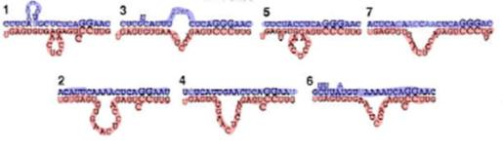
MiRNAs regulate developmental timing
lin-14 gene
lin-4 binding sites
3’ untranslated region
lin-14 mRNA
lin-4 miRNA
Lee, R.C., Feinbaum, R.L., and Ambrose, V. (1993). The C. elegans heterochronic gene lin-4 encodes small RNAs with antisense complementarity to lin-14. Cell 75: 843–845. Wightman, B., Ha, I., and Ruvkun, G. (1993) Posttranscriptional regulation of the heterochronic gene lin-14 by lin-4 mediates temporal pattern formation in C. elegans. Cell 75: 855–862.
Notes:
miRNAs were discovered in studies of developmental progressions in the nematode C. elegans.
A miRNA encoded by lin-4 is required for proper larval development

Slide 20
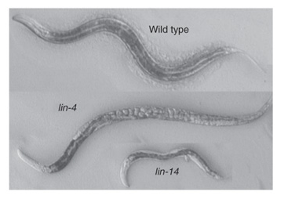
Down-regulation of lin-14 by lin-4 is necessary for normal development
lin-4 loss-of-function causes lin-14 expression to remain high.
lin-14 expression
In wild-type worms, lin-14 is expressed early and then shut off.
Lee, R.C., Feinbaum, R.L., and Ambrose, V. (1993). The C. elegans heterochronic gene lin-4 encodes small RNAs with antisense complementarity to lin-14. Cell 75: 843–845. Wightman, B., Ha, I., and Ruvkun, G. (1993) Posttranscriptional regulation of the heterochronic gene lin-14 by lin-4 mediates temporal pattern formation in C. elegans. Cell 75: 855–862.
Notes:
Adult lin-4 loss-of-function mutants lack many adult structures, and they are unable to lay eggs on account of a failure to develop a vulva, so the eggs accumulate within their bodies. lin-14 loss-of-function mutants develop certain adult features precociously at larval stages, resulting in smaller, poorly formed adults.

Slide 21
MiRNAs and vegetative phase change
Vegetative phase change
Germination
zygote
EMBRYONIC PHASE
JUVENILE PHASE
ADULT PHASE
REPRODUCTIVE PHASE
Notes:
Vegetative phase change is the transition from juvenile to adult growth in plants

Slide 22
MiR156 targets SPL genes, promoters of phase change
miR156 binding site
SPL3
Promoter
ORF
3’ UTR
miR156
SPL
Notes:
The SPL genes are a family of transcription factors that are miR156 targets
In wild-type plants, miR156 expression decreases with plant age, allowing SPL to accumulate and promote phase change.

Slide 23

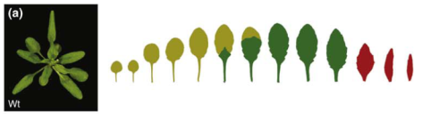

MiR156 loss-of-function promotes precocious phase change
miR156 OX
Wild-type
miR156
SPL
miR156-loss-of-function
SPL
Reprinted from Poethig, R.S. (2009) Small RNAs and developmental timing in plants. Curr. Opin. Genet. Devel. 19: 374-378, with permission from Elsevier.

Slide 24
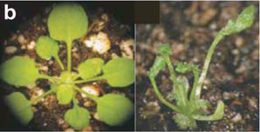
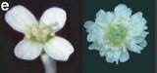
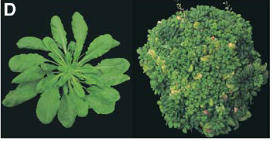
MicroRNAs are critical in plant development
Jones-Rhoades et al., (2006) Annu. Rev. Plant Biol 57: 19-53
Schwab et al., (2005) Dev Cell: 517-527
Notes:
miRNAs are a class of endogenous small non-coding RNAs that play crucial roles in both plants and animals. In plants, miRNAs play important roles in many biological processes. These pictures show plants in which miRNA regulation has been disturbed and you can see that all of them show dramatic phenotypes, so miRNAs are very important for proper plant development.

Slide 25
Difference between plant and animal miRNA systems
Plant
Animal
Target gene
miRNA
Target gene
miRNA
coding region
3’ UTR
coding region
3’ UTR
High target complementary
Transcriptional cleavage & translational repression
Single target sequence
Located in open reading frame
Low target complementary
Translational repression and mRNA decay
Multiple target sequences
Located in 3’ UTR
Different miRNAs can target the same gene

Slide 26
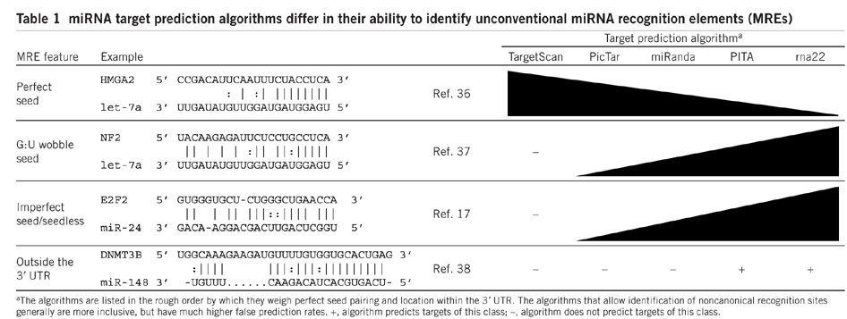
Bioinformatic prediction of miRNA targets
Main criteria: Base pairing, target site location, evolutionary conservation of target site, target accessibility.
Nature Structural & Molecular Biology 17, 1169–1174 (2010)
Notes:
Results differ from program to program. High false-positive rates are often observed due to the unpredictable complexity of in vivo situations.

Slide 27
Methods for identifying miRNA targets
Normalization, data analysis, statistics
Primary gene list
Modified from Nature Structural & Molecular Biology 17, 1169–1174 (2010)
GO, interactome and pathway analysis
Candidates for experimental testing
Notes:
GO: Gene ontology
The Gene Ontology project is a major bioinformatics initiative with the aim of standardizing the representation of gene and gene product attributes across species and databases.
Because miRNAs reduce the steady-state transcript levels of most target genes^{6, 21, 22, 23}, identifying mRNAs that are downregulated after ectopic miRNA expression or upregulated after miRNA antagonism provides a useful way to identify putative miRNA-regulated genes (Fig. 1). Although this method cannot distinguish direct from indirect targets, harvesting cells soon after transfection might enhance the proportion of direct targets
Proteomic analysis can also identify miRNA targets. Stable isotope labeling with amino acids in cell culture (SILAC) followed by mass spectrometry can assess the effect of the loss or overexpression of miRNAs on global protein expression
The mammalian miRISC contains a mature miRNA and several proteins, including an Ago protein and Tnrc6 (refs. 62, 63). Several studies have identified miRNA targets by their association with miRISC proteins, using immunoprecipitation of epitope-tagged miRISC components^{27, 28, 29, 30} or native miRISC³¹, often while manipulating a specific miRNA to identify its targets

Slide 28
Degradome for the study of cleaved miRNA targets
Nature Protocols 4, 356 - 362 (2009)
Notes:
Parallel Analysis of RNA Ends (PARE) libraries

Slide 29
Degradome reveals in vivo miRNA:target interaction
Target plots of validated target mRNAs
Nature Biotechnology 26, 941 - 946 (2008)

Slide 30
Studying miRNA function is difficult
Function of most miRNAs is still unknown.
Difficult to obtain loss-of-function mutants:
Small size of MIR genes
Genetic redundancy between miRNA family members
New methodologies to inhibit miRNAs based on the expression of decoy targets.

Slide 31
Expression of miRNA-resistant target can reveal miRNA functions
miR159
MYB33
WT

Slide 32
MiRNA sponges inhibit animal/plant miRNA activities
No decoy
miRNA sponge
Target gene
5’
A(n)
5’
A(n)
AGO
AGO
AGO
miRNA-mediated repression
De-repression of miRNA target
miRNA-mediated repression

Slide 33
MiRNA sponges inhibit animal/plant miRNA activities
Each binding site has central mismatches to prevent being cleaved by miRNA.
35S promoter
5’
A(n)
miRNA binding sites (15x)
4 nt spacer
primer sites
Wild type
SP159
SP165/166
(Marlene Reichel, unpublished data)

Slide 34
miR399 activity is reduced when IPS1 is present
No IPS1
IPS1 present
miR399
miR399
PHO2
PHO2
miR399 binds to and cleaves PHO2.
No PHO2 made, no phosphate uptake
miR399 sequestered.
PHO2 translated, phosphate uptake

Slide 35
Target mimic can be utilized to study miRNA functions
35S
MIM
IPS1
MIMIC
miRNA
21 20 19 18 17 16 15 14 13 12 11 10 9 8 7 6 5 4 3 2 1

Slide 36
A collection of target mimics for Arabidopsis microRNAs
PLoS Genet 6(7): e1001031 (2010)

Slide 37
Development of artificial microRNAs
amiRNA-1
amiRNA-2
Wild-type
amiRNA transgeneic plants
amiRNA-1
amiRNA-2

Slide 38
MicroRNAs regulate oncogenes and tumour suppressors

Slide 39
Great potential to treat human diseases
Various cancers: loss or up-regulated microRNAs, also can be due to altered miRNA:target interaction.
Diabetics: microRNA regulate insulin secretion
Obesity: microRNA regulate fat metabolism in livers
Neuronal disease (aging): microRNA changes
Viruses: microRNA have antiviral activity
Stem cells: microRNA control differentiation and renewal

Slide 40
MiRNA vs siRNA
21-22 nucleotides
Imperfect match
Translational repression or mRNA cleavage
Highly conserved
Encoded by endogenous genes
Targets different sequence from which they were derived
21-24 nucleotides
Perfect match
mRNA cleavage/DNA methylation
Not conserved between species
Endogenous/foreign (viruses) genes
Targets the same sequence from which they were derived

Slide 41
small RNAs: more types and classifications
hpRNA-derived
dsRNA-derived
Precisely processed miRNAs
Imprecisely processed, not miRNAs
Intergenic and heterochromatin-derived siRNAs
Secondary siRNAs, precursor produced by action of RNA-dependent RNA polymerase
Natural-antisense transcript-derived
nat-siRNAs: precursor RNA formed by hybridization of two independent RNAs
Trans-acting siRNAs
(ta-siRNAs or tasiRNAs)
Phased siRNAs
RDR
Adapterd from Axtell, M.J. (2013). Classification and comparison of small RNAs from plants. Annu. Rev. Plant Biol. 64 [in press].

Slide 42
tasiRNAs: trans-acting siRNAs
Encoded by TAS genes
Primary transcript processing initiated by miRNA
TAS gene
tasiRNAs are encoded by TAS genes that are transcribed by RNA Pol II
RNA Pol II
The transcript is targeted by a miRNA and cleaved
AGO
The cleaved transcript is copied to dsRNA by an RNA-dependent RNA polymerase, RDR6
(continued on next slide...)
DICER
RDR6

Slide 43
tasiRNA biogenesis
The dsRNA is cleaved by DCL4 into a series of shorter dsRNAs, releasing many tasiRNAs from a single TAS gene.
Arabidopsis has 4 families of TAS genes
TAS1 and TAS2 tasiRNAs target pentatricopeptide repeat genes.
TAS3 tasiRNAs target ARF transcription factors.
TAS4 tasiRNAs target MYB transcription factors
DICER

Slide 44
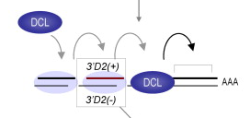
Several “phased” tasiRNAs are derived from each TAS gene
The tasiRNAs can be produced from either strand.
miRNA cleavage site of primary transcript
DCL4 moves along the dsRNA, measuring and cutting
Reprinted from Allen, E., Xie, Z., Gustafson, A M., and Carrington, J.C. (2005) microRNA-directed phasing during trans-acting siRNA biogenesis in plants. Cell 121: 207-221, with permission from Elsevier.

